Slide 1
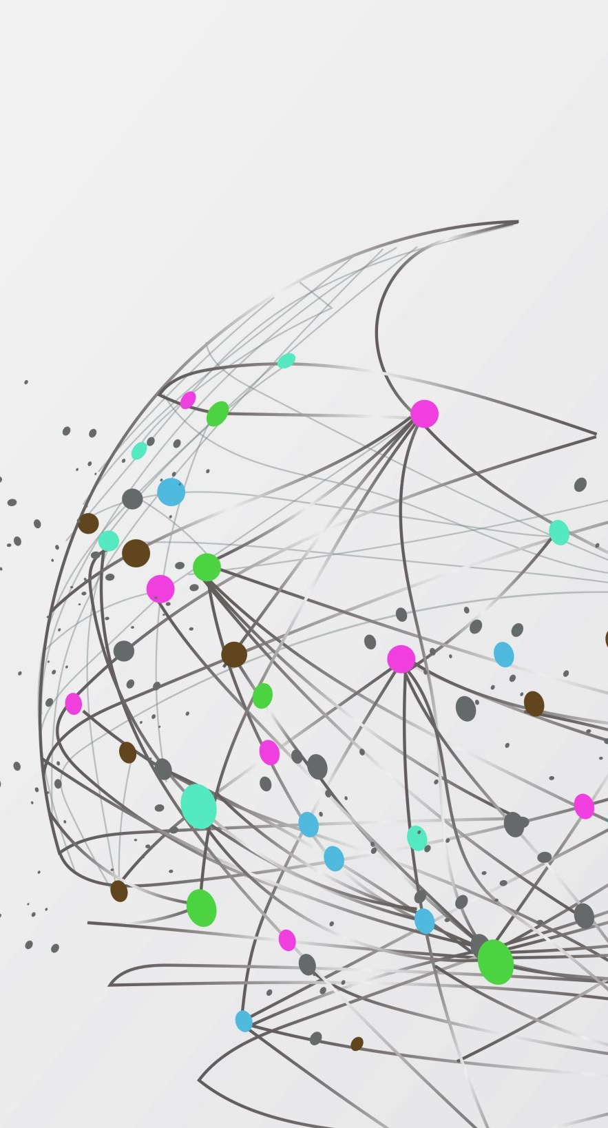
Claim Span Task A
Uncovering Truth in Social Media through Claim Detection
M Yagnesh
2023AIB2069

Slide 2
Abstract
This project addresses the challenge of identifying misinformation in COVID-19-related tweets using deep learning.
Given the proliferation of false news and misinformation on social media, especially concerning COVID-19, a BERT-based model is employed to detect claims.
The model is trained on a dataset of COVID-19 tweets labeled as claims or non-claims.

Slide 3
Problem Statement
The rapid expansion of social media platforms has exacerbated the spread of misinformation, particularly during the COVID-19 "Infodemic."
Despite efforts by social media platforms to combat misinformation through content moderation, the sheer volume of data makes effective moderation challenging.
Therefore, there is a pressing need for a robust and automated solution to detect and differentiate between true and false claims in COVID-19-related Twitter data, ensuring the reliability of shared information.

Slide 4
Introduction
The exponential growth of social media has led to the widespread dissemination of misinformation, particularly during the COVID-19 "Infodemic."
Content moderation on social media platforms faces challenges due to the sheer volume of data.
A deep learning-based technique using a BERT-based model is developed to automatically detect and differentiate between true and false claims in COVID-19-related Twitter data, providing insights into the reliability of shared information.

Slide 5
Dataset
Data Set | Claim | Non-Claim
Train | 6106 | 880
Valid | 1301 | 196
The dataset consists of tweets which are classified into claims and non claims and the following is the composition of tweets i the dataset
The problem with this dataset is the composition of data. It is too skewed and it also contains unwanted data such as urls and emotes
Tweet Text | Claim
RT @meanguitar: Breaking news: #China will admit #coronavirus coming from its P4 lab #BioWeapon - https://t.co/JywpSu35rN | 1
Retweet this if you still have no idea how to get tested for the #coronavirus. | 0

Slide 6
Pre-processing and Tokenization
The data has unnecessary information like urls and emojis which are removed during pre-processing
The BERT tokenizer is used to tokenize and encode preprocessed text data for training, utilizing the bert-base-uncased pre-trained model.
Tokenization breaks down the input text into tokens, which are then encoded into numerical IDs, with a maximum sequence length of 128 tokens.
PyTorch Dataset and DataLoader classes are employed to efficiently load the tokenized and encoded data in batches for training and evaluation.

Slide 7
Model
The claim detection model is based on the BERT (Bidirectional Encoder Representations from Transformers) architecture, utilizing the pre-trained BERT model bert-base-uncased with additional layers for fine-tuning.
A fully connected feed-forward neural network (FFN) is added on top of the pre-trained BERT model, consisting of dropout layers, hyperbolic tangent (Tanh) activation functions, layer normalization, and linear layers for binary classification.

Slide 8
Model
The BERTClass class defines the claim detection model, initializing the pre-trained BERT model (bert-base-uncased) and adding additional FFN layers on top.
During initialization, the parameters of the BERT model are frozen, except for the top 4 layers, which are unfrozen for weight updates during fine-tuning.
The forward method of the model takes input IDs and attention masks as input and returns the model output, representing the predicted claim label for each input text.

Slide 9
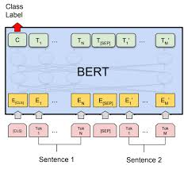
Model Architecture
The architecture is as follows
A FFN is appleid on top of BERT which contains 2 layers with dropouts 0.6,0.3 and activation function tanh on 1st layer of FFN
The FFN gives single output over which sigmoid is applied and loss is calculated is BCEWithLogitsLoss

Slide 10
Hyper-Parameters
Hyperparameter | Value
Maximum Length | 128
Batch Size | 16
Learning Rate | 1e-5 (Initially), reduce 20% in each epoch for upto 8 epochs
Class Weights | based on class distribution
Number of Epocs | 20

Slide 11
Validation Results
Since the dataset is skewed, the metrics accuracy, Precision donot explain the model clearly
Hence, we use Macro F1 score
The macro F1 score is avg(F1 scores) of all the classes with no regard for classs weights
Metric | Value
Accuracy | 0.8965
Macro F1 Score | 0.7032
Precision | 0.9081
Recall | 0.98
F1 Score | 0.9427

Slide 12
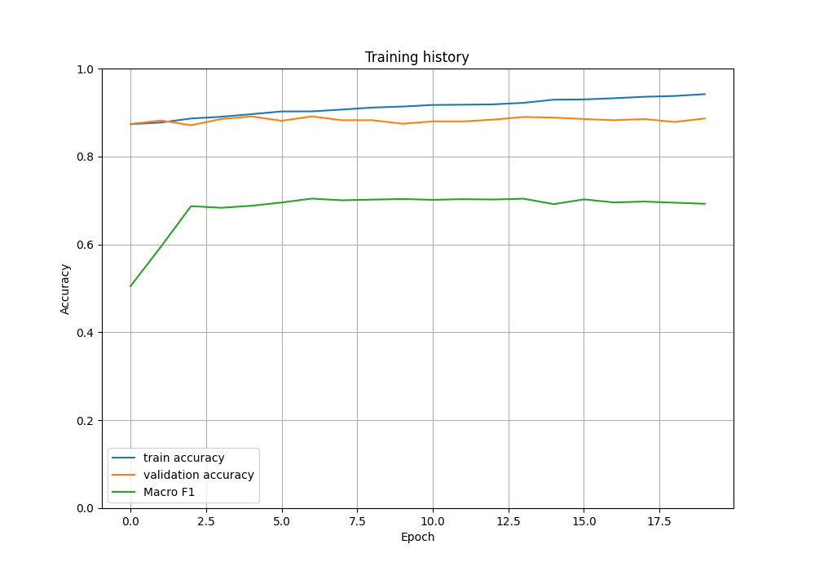
Results
During training, validation loss increases across epochs while training loss decreases, indicating potential overfitting.
To address overfitting, regularization techniques such as dropout, L2 regularization, and early stopping are employed.
Although early stopping is not implemented, the model is saved at the epoch with optimal values of Macro-F1 score and accuracy on the validation data.
This allows for further evaluation of the model to ensure it recovers or reduces loss in subsequent steps.

Slide 13
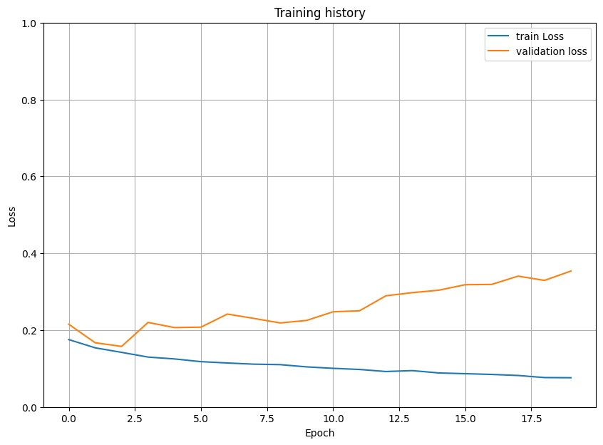
Results
The graph shows that the model starts with good scores and gradually improves during training, reaching a plateau after some epochs.
This suggests that the hyperparameters are well-suited for the model, providing a good starting point and facilitating better performance, particularly with a small training dataset.

Slide 14
Performance in competetion
Claim Scan Task A
ClaimScan 2023
Index | Name | Accuracy
 | Benchmark | 1.0000
1 | test_claim | 0.90448
2 | Yagnesh | 0.89971
3 | cehen44936 | 0.98780
4 | Samarth Singla | 0.89398
Rank | Name | Macro-F1
 | Yagnesh | 0.7032
1 | NLytics | 0.7002
2 | bhoomeendra | 0.6900
3 | amar8ta | 0.6324
4 | pakapro | 0.4321

Slide 15
Future Work
The BERTClass class defines the claim detection model, initializing the pre-trained BERT model (bert-base-uncased) and adding additional FFN layers on top.
During initialization, the parameters of the BERT model are frozen, except for the top 4 layers, which are unfrozen for weight updates during fine-tuning.
The forward method of the model takes input IDs and attention masks as input and returns the model output, representing the predicted claim label for each input text.

Slide 16
References
1. Megha Sundriyal, Md Shad Akhtar and Tanmoy Chakraborty, Overview of the CLAIMSCAN-2023: Uncovering Truth in Social Media through Claim Detection and Identification of Claim Spans https://arxiv.org/pdf/2310.19267
2. ClaimScan Task A https://www.kaggle.com/competitions/claimscan-task-a
3. M. Sundriyal, P. Singh, M. S. Akhtar,S. Sengupta, T. Chakraborty, Desyr: definition and syntactic representation based claim detection on the web, in: Proceedings of the 30thACM International Conference on Information & Knowledge Management, 2021, pp. 1764–1773.

Slide 17
Thank You

